Slide 1


Stock Portfolio Analyzer
Team members:
Cesar Estrada
Kacie Motley
Liza Gino
Randy Miyazaki
Yi Li

Slide 2
Project Overview
Historical
Import 10 year’s stock price data for Top 10 large market cap companies
Analysis
Use Sharpe Ratio, Monte Carlo, Geometric Brownian Motion (GBM), Omega Ratio
Investment
Pick 3 out of 10 stocks
to build up a stock portfolio

Slide 3
Data Collection, Cleanup & Exploration
Alpaca API – collect historical stock data
Load alpaca key → run tradeapi.REST function → run alpaca.get_bars function
Data cleanup
Create Dataframe
Use drop function

Slide 4
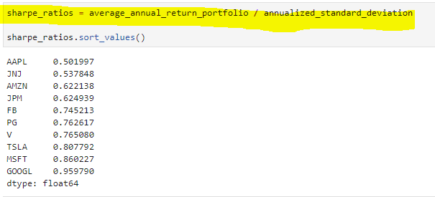
Stock Portfolio Analysis
Sharpe Ratio

Slide 5
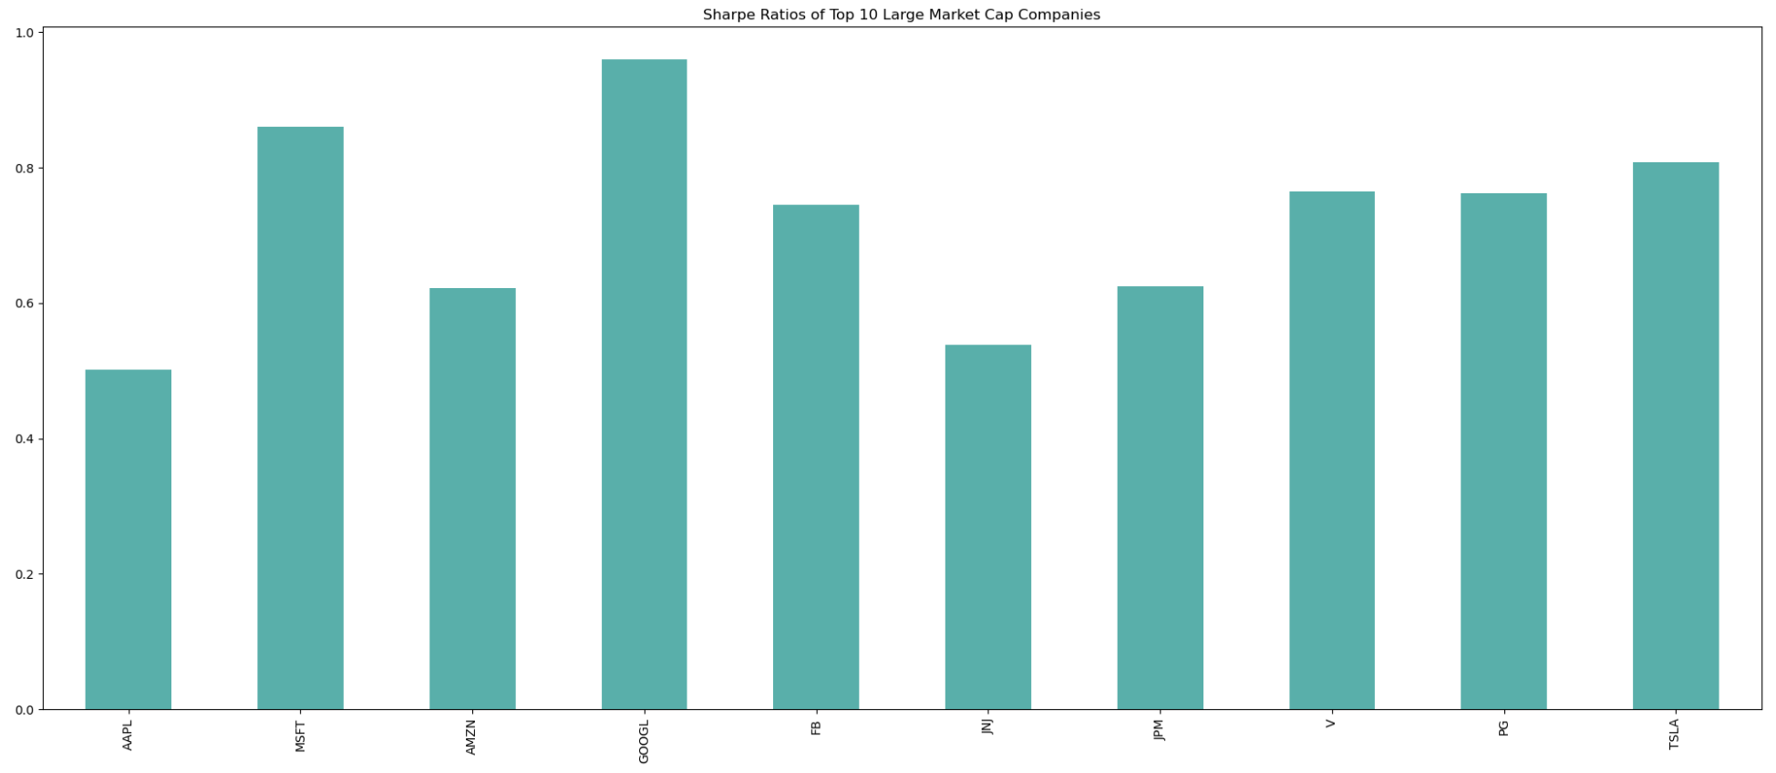
Stock Portfolio Analysis
Sharpe Ratio

Slide 6
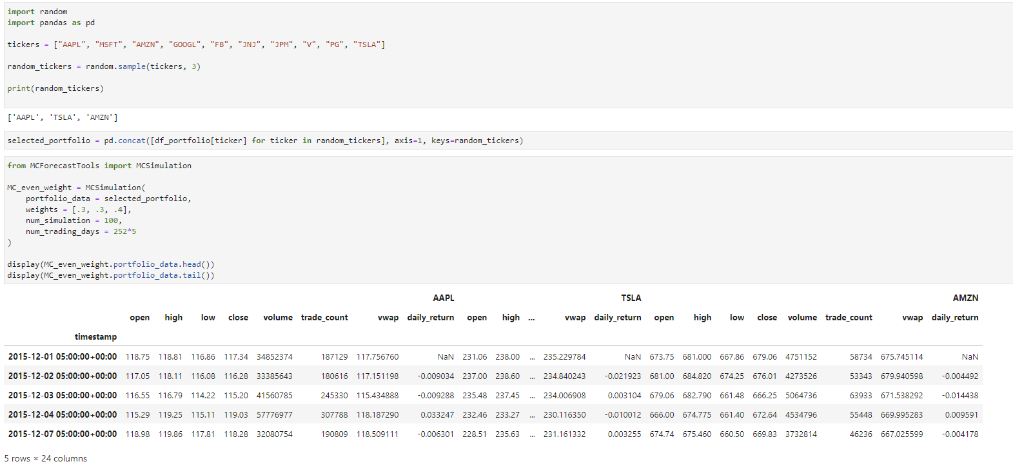
Stock Portfolio Analysis
Monte Carlo – randomly pick 3 stocks

Slide 7
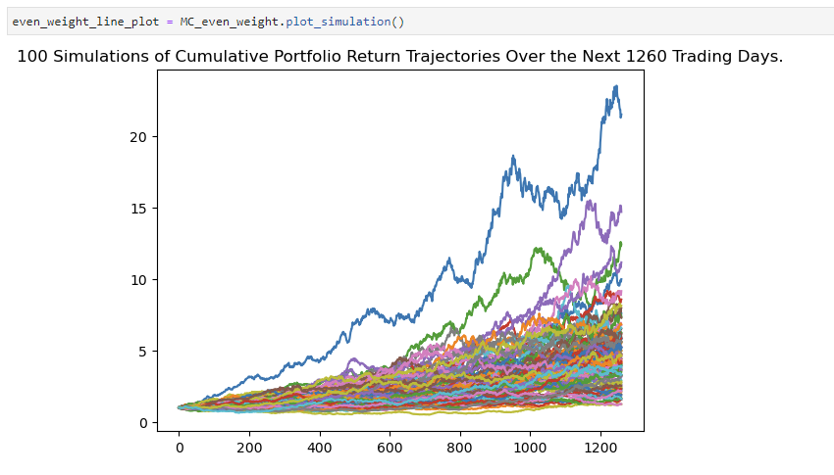
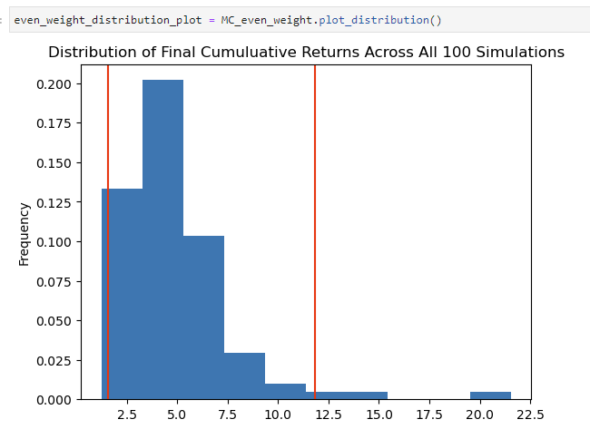
Stock Portfolio Analysis
Monte Carlo – randomly pick 3 stocks

Slide 8
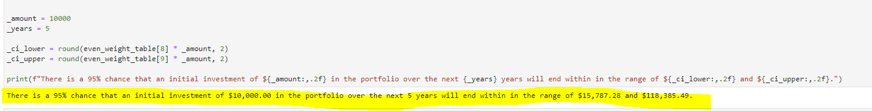
Stock Portfolio Analysis
Monte Carlo – randomly pick 3 stocks

Slide 9
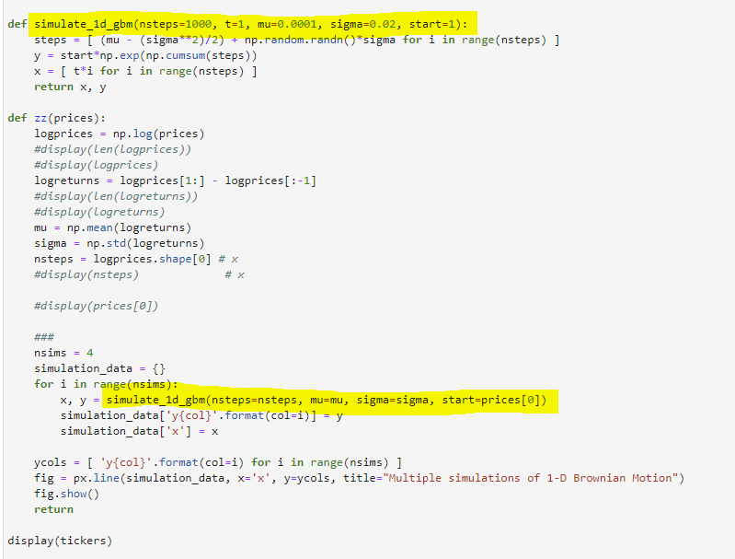
Stock Portfolio Analysis
Geometric Brownian Motion (GBM) – describe the random movement of a variable over time – to estimate the probability of a stock price hitting a certain level at a certain time in the future.

Slide 10
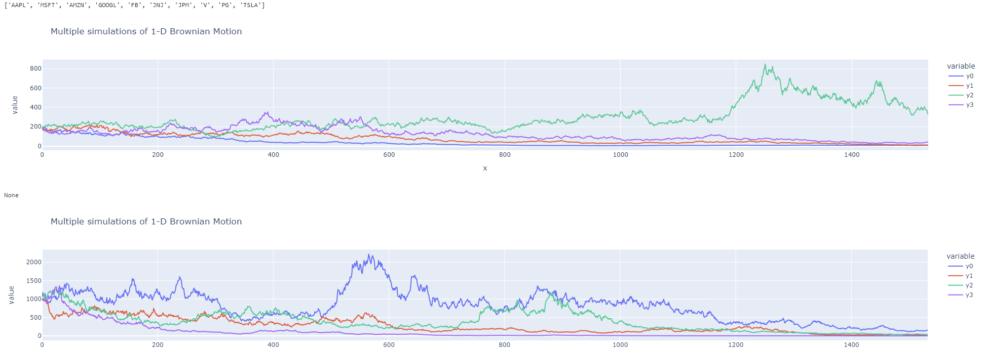
Stock Portfolio Analysis
Geometric Brownian Motion (GBM)

Slide 11
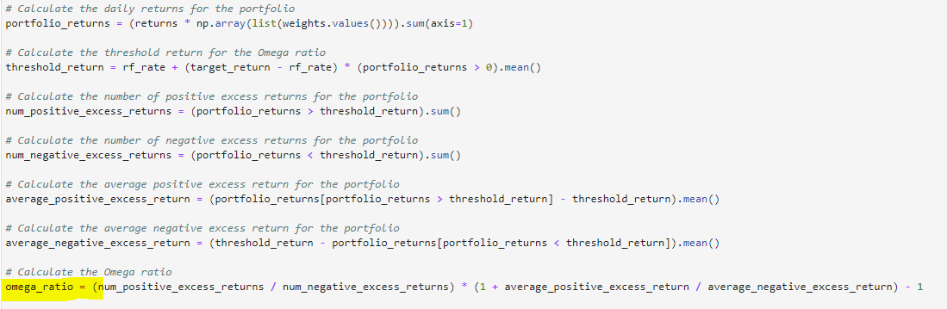
Stock Portfolio Analysis
Omega Ratio - measures the probability-weighted ratio of gains versus losses in an investment portfolio.

Slide 12
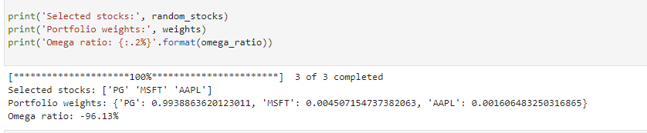
Stock Portfolio Analysis
Omega Ratio – randomly pick three stocks

Slide 13
Build up a Stock Portfolio
Compare the results:
Sharpe Ratio,
Monte Carlo,
Geometric Brownian Motion (GBM),
Omega Ratio
Pick 3 stocks with different weights

Slide 14
Questions?

